Slide 1
Real State vs. Simulated State
CS 5010 Program Design Paradigms
"Bootcamp"
Lesson 10.3
© Mitchell Wand, 2012-2014
This work is licensed under a Creative Commons Attribution-NonCommercial 4.0 International License.

Slide 2
Real State vs. Simulated State
Before, our objects were immutable. If we needed to construct an object with a different state, we just constructed a new one.
But we couldn't do that and have objects with stable identities.
In this lesson, we'll consider the difference between "real state" and "simulated state".

Slide 3
Let's think about traffic lights
nextstate : TLState → TLState
If the traffic light were in state s, what state should it be in next?
This is a specification of how a traffic light should behave.
This is simulated state: a mathematical function
Real state: make the traffic light change to the next state!

Slide 4
Similarly for on-tick
on-tick : WorldState → WorldState
If the world is in state s, what state should it be in after the next tick?
This is a specification of the desired behavior of the world.
It's just a mathematical function.
big-bang takes these functions and constructs a world that really behaves that way.

Slide 5
Real state is about sharing
How can you tell the difference between a traffic light and a TLState?
Ans: everybody sees the same traffic light.
The traffic light has a stable identity.
If its state changes everybody sees it.

Slide 6
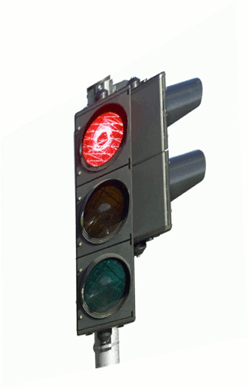


Are they seeing the traffic light or a model of the traffic light?

Slide 7
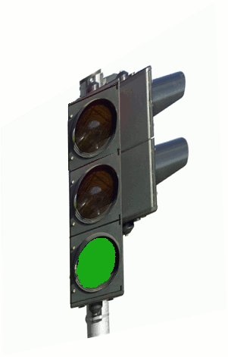
Are they seeing the traffic light or a model of the traffic light?
Notes:
// must capture this animation!! //

Slide 8
Are they seeing the traffic light or a model of the traffic light?
Now we know!
Notes:
// must capture this animation!! //

Slide 9
What just happened?
The people who were looking at the real traffic light saw it change to green.
The people who were looking at the simulated traffic light (in their newspapers) didn't see the change.

Slide 10
States vs. Values
TLStates are just values. They never change. "red" is always "red".
The traffic light was an object with stable identity, which had real state: the light could change from one TLState to another.
If two observers are looking at the same object, and the object's state changes, then both observers see the change.

Slide 11
Blackboard metaphor
State is like a blackboard: when I write on the blackboard, everybody sees it, because you are all looking at the same blackboard.
The blackboard has a stable identity!
With state, I don't care who's in the room.
I could distribute the changes by sending messages to each of you, but then I'd have to know who I needed to talk to.
That's what we do when we pass parameters in our programs!
Blackboards foster collaboration

Slide 12
Where is the state?
In World programs, there was just one piece of state– the world– and it was kept inside big-bang.
In OO system, each object can have its own state.
This complicates things

Slide 13
An object is a little blackboard
Lots of little blackboards!
Of course you can't just look at a blackboard, you have to ask it questions, like
(send traffic-light1 are-you-red?)
This means we have to worry about patterns of collaboration again.

Slide 14
What has to be shared in our example?
When the wall changes, all the balls have to see it.
The balls all have to look at the same wall.
So let's make the wall stateful.
In the next lesson, we'll see how to design code that accomplishes.
Remember, "design" means getting what you know out of your head and onto the page

Slide 15
Next Steps
If you have questions about this lesson, ask them on the Discussion Board
Go on to the next lesson

